Slide 1
Team 2A
Differential analysis of 2D graphs

Slide 2
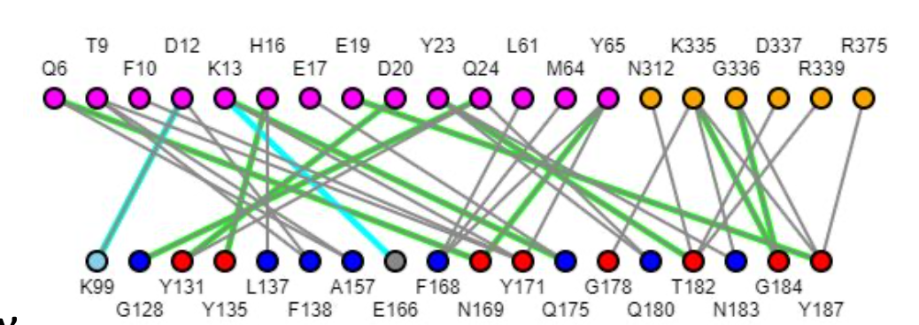
Concept
3D structure > 2D networks > comparison between two networks
Apply to RBD-ACE2 with CoV variants
Youkharibache, Cachau, Madej and Wang, 2020. Preprint.

Slide 3
Goals
Aim | Quantitative description of the aim
1 | Automated differential residue interaction network (contacts) identification between 2 arbitrary sets of residues (1 level). Application to RBD-ACE2 for SARS-CoV variants Goal: Identification/visualization of key interactions gained/lost
2 | Contact tracing of secondary+ interactions (how does this affect structure, etc)
3 | Visualization of differences vs. conserved interactions in 2D (subnetworks), Parallel “diff” Tables of interactions the residue and atom level
4 | Integration of side-by-side views generalizable to all visualization types, particularly for 2D (can be network or contact map)

Slide 4
Organization
Goal | Members Contributing
Contact Mapping | Yuk Kei, Tom
Visualization of Differential Connectors as subnetworks | Mingzhang
Differential tables (residue and atomic) | Adriaan
Residue Networks (residues as nodes) | Peter
Interaction Networks (edges as nodes) | Xavier (2c), Tom
Contact Tracing/secondary + interactions | Peter, Awtum, Tom
Side-by-Side visualizations | Mingzhang

Slide 5
Brainstorm ideas
Contact mapping
Yuk Kei created code that obtains matrix of residues from HTML file
X an y axis from matrix as residues plotting
Superimposition of 2 grids
Javascript for grid management
Visualization
Existing javascript libraries, potentially (D3)
# of atomic contacts between 2 residues as a size for the edge -- how to inform on bond types
Differential networks
Edge networks
Unique rows between two network tables > differential, same rows > conserved

Slide 6
Redistributions & Future Goals
Aim | Quantitative description of the aim
Jiyao | In collaboration with Team 1B: Link the interaction window currently at the chain level with computed interaction networks at the residue level (Jiyao)
Collaboration with 2C | 2b database goals. Dataset creation
Jiyao/Future project | Can we envision visualization of intermolecular interactions between 1D tracks Can we envision visualization of intramolecular interactions networks within 1D track [Hbonds, Cys bridge in particular]
 | R integrations/support

